Slide 1
CST426 - CLIENT SERVER ARCHITECTURE

Slide 2
Module – 2 (Client/Server Application Components)
Classification of Client/Server Systems
Two-Tier Computing
Middleware
Three-Tier Computing
Model View Controller (MVC)
Principles behind Client/Server Systems.
Client/Server Topologies
Existing Client/Server Architecture.
Architecture for Business Information System.

Slide 3
Client/Server: Fat or Thin
A Client or a Server is so named depending on the extent to which the processing is shared between the client and server.
A thin client is one that conducts a minimum of processing on the client side.
A fat client is one that carries a relatively larger proportion of processing load.
The concept of Fat Clients or Fat Servers is given by one of the important criterion - how much of an application is placed at the client end vs. the server end.

Slide 4
Fat Clients: This architecture places more application functionality on the client machine(s).
They are used in traditional of Client/Server models.
Their use can be a maintenance headache for Client/Server systems.

Slide 5
Fat Servers: This architecture places more application functionality on the server machine(s).
Typically, the server provides more abstract, higher level services.
The current trend is more towards fat servers in Client/Server Systems.
The client is often found using a fast web browser.
The biggest advantage of using the fat server is that it is easier to manage because only the software on the servers needs to be changed, whereas updating potentially thousands of client machines is a real headache.

Slide 6
Client/Server: Stateless or Stateful
A stateless server is a server that treats each request as an independent transaction that is unrelated to any previous request.
The biggest advantage of stateless is that it simplifies the server design because it does not need to dynamically allocate storage to deal with conversations in progress or worry about freeing it if a client dies in mid-transaction.
Disadvantage: it may be necessary to include more information in each request and this extra information will need to be interpreted by the server each time.
An example of a stateless server is a World Wide Web server.
With the exception of cookies, these take in requests (URLs) which completely specify the required document and do not require any context or memory of previous requests.

Slide 7
Stateful Server
Client data (state) information are maintained by server on status of ongoing interaction with clients.
The server remembers what client requested previously and at last maintains the information as an incremental reply for each request.
The advantages of stateful server is that requests are more efficiently handled and are of smaller in size.
Disadvantages :
state information becomes invalid when messages are unreliable.
if clients crash (or reboot) frequently, state information may exhaust server’s memory.
The best example of stateful server is remote file server.

Slide 8
Stateless vs Stateful Servers
A stateful server remembers client data (state) from one request to the next.
A stateless server keeps no state information.
Using a stateless file server, the client must specify complete file names in each request, specify location for reading or writing and re-authenticate for each request.
Using a stateful file server, the client can send less data with each request. A stateful server is simpler.
A stateless server is more robust and lost connections can’t leave a file in an invalid state, rebooting the server does not lose state information, rebooting the client does not confuse a stateless server.

Slide 9
Servers and Mainframes
The CPU inside a mainframe was much faster than a personal computer.
A mainframe most closely resembled a LAN.
A mainframe was ‘larger’ in terms of:
The raw speed expressed in instructions per second, or cycles.
The amount of memory that could be addressed directly by a program.
Mainframes are the monstrous computer system that deals mainly the business functions and technically these giant machines will run MVS, IMS and VSAM operating systems.

Slide 10
There is a common believe that a mainframe is ‘database’. There are many reasons behind this belief:
Many servers are either file or database servers running sophisticated database such as Sybase, Oracle and DB2.
These servers connect to the mainframe primarily to access databases.
Organisations use servers specifically to replace mainframe databases.
Organisations keep applications on the mainframe usually for better database performance, integrity and functionality.

Slide 11
How do Client/Server Systems differ from Mainframe Systems?
The extent of the separation of data processing task is the key difference.
In mainframe systems all the processing takes place on the mainframe and usually dumb terminals are used to display the data screens. These terminals do not have autonomy.
On the other hand, the Client/Server environment provides a clear separation of server and client processes, both processes being autonomous.
The relationship between client and server is many to many.

Slide 12
Client/Server Functions
The main operations of the client system are listed below:
Managing the user interface.
Accepts and checks the syntax of user inputs.
Processes application logic.
Generates database request and transmits to server.
Passes response back to server.

Slide 13
The main operations of the server are :
Accepts and processes database requests from client.
Checks authorization.
Ensures that integrity constraints are not violated.
Performs query/update processing and transmits responses to client.
Maintains system catalogue.
Provide concurrent database access.
Provides recovery control.

Slide 14
Client/Server Topologies
A Client/Server topology refers to the physical layout of the Client/Server network in which all the clients and servers are connected to each other.
This includes all the workstations (clients) and the servers.
The possible Client/Server topological design and strategies used are as follows:
Single client, single server
Multiple clients, single server
Multiple clients, multiple servers

Slide 15
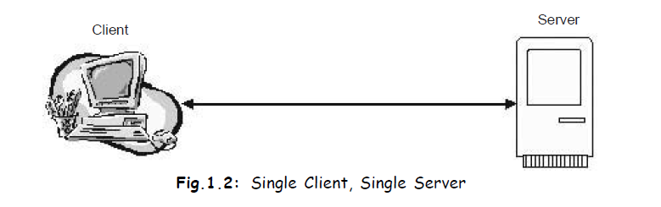
Single client, single server
In this topology, one client is directly connected to one server.

Slide 16
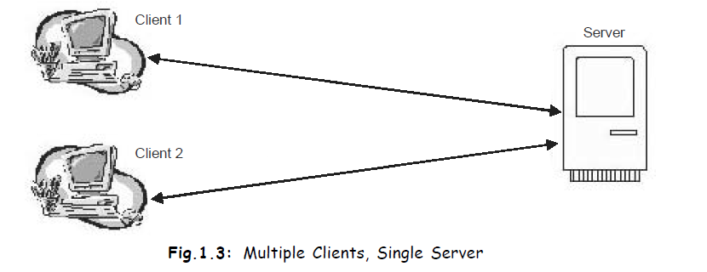
Multiple clients, single server
In this topology, several clients are directly connected to only one server.

Slide 17
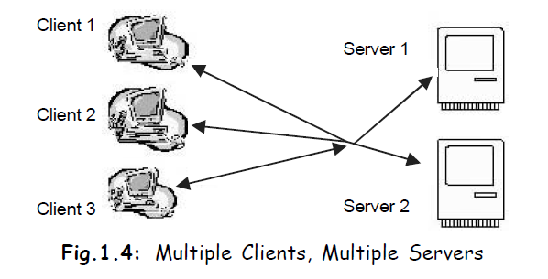
Multiple clients, multiple servers
In this topology several clients are connected to several servers.

Slide 18
CLASSIFICATION OF CLIENT/SERVER SYSTEMS
There are three types of Client/Server systems.
Two-tier
Three-tier
N-Tier

Slide 19
Two-tier Client/Server Model
The application processing is done separately for database queries and updates and for business logic processing and user interface presentation.
The network binds the back-end of an application to the front-end, although both tiers can be present on the same hardware.

Slide 20
Sometimes, the application logic (the real business logic) is located in both the client program and in the database itself.
Quite often, the business logic is merged into the presentation logic on the client side.
As a result, code maintenance and reusability become difficult to achieve on the client side.
On the database side, logic is often developed using stored procedures.

Slide 21
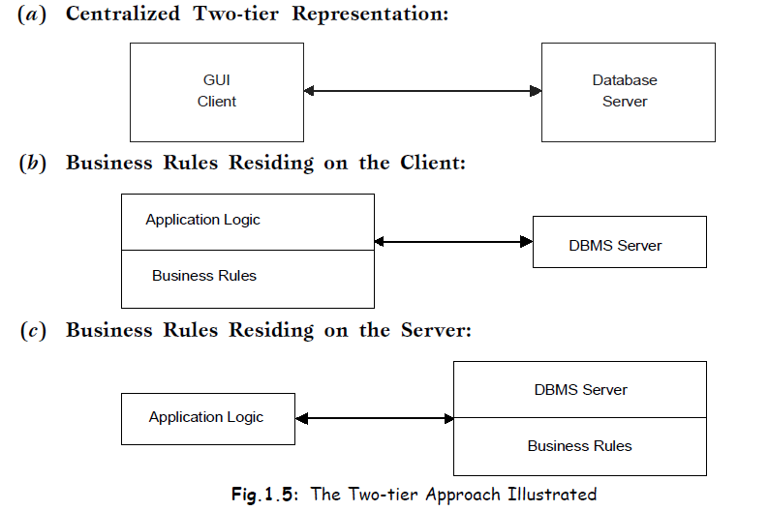
In the two-tier architecture, if the Client/Server application has a number of business rules needed to be processed, then those rules can reside at either the Client or at the Server.

Slide 22
The architecture of any client/server environment is by definition at least a two-tier system, the client being the first tier and the server being the second.
The Client requests services directly from server i.e. client communicates directly with the server without the help of another server or server process.
In a typical two-tier implementation, SQL statements are issued by the application and then handed on by the driver to the database for execution.
The results are then sent back via the same mechanism, but in the reverse direction.

Slide 23
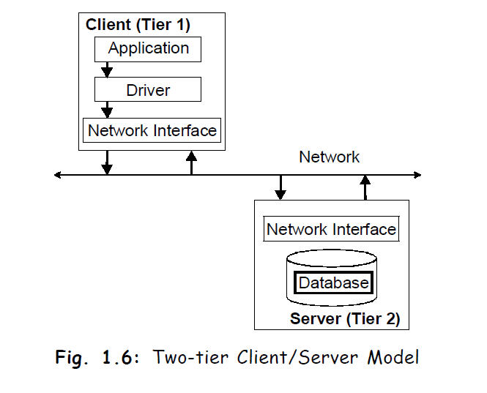

Slide 24
Advantages of two-tier systems
Availability of well-integrated PC-based tools like, Power Builder, MS Access, 4 GL tools provided by the RDBMS manufacturer, remote SQL, ODBC.
Tools are relatively inexpensive.
Least complicated to implement.
PC-based tools show Rapid Application Development (RAD) i.e., the application can be developed in a comparatively short time.
The 2-tier Client/Server provides much more attractive graphical user interface (GUI) applications than was possible with earlier technology.

Slide 25
Architecture maintains a persistent connection between the client and database, thereby eliminating overhead associated with the opening and closing of connections.
Faster than three-tier implementation.
Offers a great deal of flexibility and simplicity in management.

Slide 26
Disadvantages of two-tier architecture
As the application development is done on client side, maintenance cost of application, as well as client side tools etc. is expensive. That is why in 2-tier architecture the client is called ‘fat client’.
Increased network load: Since actual processing of data takes on the remote client, the data has to be transported over the network. This leads to the increased network stress.
Applications are loaded on individual PC i.e. each application is bound to an individual PC. For this reason, the application logic cannot be reused.
Due to dynamic business scenario, business processes/logic have to be changed. These changed processes have to be implemented in all individual PCs. Not only that, the programs have to undergo quality control to check whether all the programs generate the same result or not.

Slide 27
Software distribution procedure is complicated in 2-tier Client/Server model. As all the application logic is executed on the PCs, all these machine have to be updated in case of a new release. The procedure is complicated, expensive, prone to errors and time consuming.
PCs are considered to be weak in terms of security i.e., they are relatively easy to crack.
Most currently available drivers require that native libraries be loaded on a client machine.
Load configurations must be maintained for native code if required by the driver.
Problem areas are encountered upon implementing this architecture on the Internet.

Slide 28
Three-tier Client/Server Model
To avoid embedding the application’s logic at both the database side and the client side, a third software tier is inserted in between.
In the three-tier architecture, most of the business logic is located in the middle tier.
In this structure, when the business activity or business rules change, only the middle tier must be modified.

Slide 29
In three-tier architecture, the business system must provide three types of main services:
Presentation (GUI) or user services
Application services or business rules
Database services or data server

Slide 30
Presentation (GUI) or user services:
Include maintaining the graphical user interface and generating what users see on the monitor.
Presentation Logic dealing with:
Screen formatting
Windows management
Input editing
What-if analysis

Slide 31
Application services or business rules:
These include executing applications and controlling program flow. Business logic dealing with:
Domain and range validation
Data dependency validation
Request/response architecture of Inter Process Communication level
Database services or data server: Which refers to the management of underlying databases. Server logic deals with:
Data access
Data management
Data security
SQL parsing

Slide 32
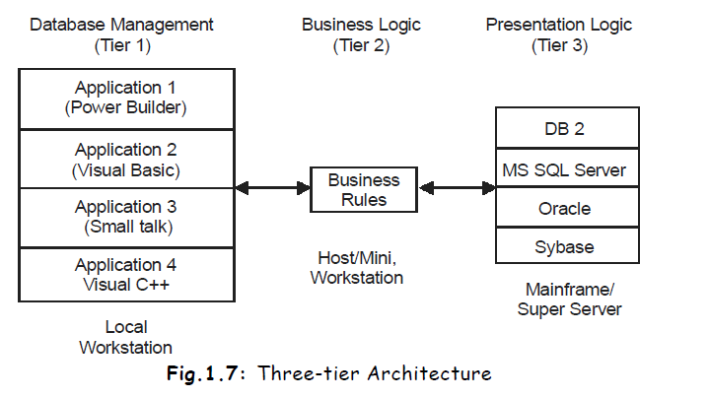

Slide 33
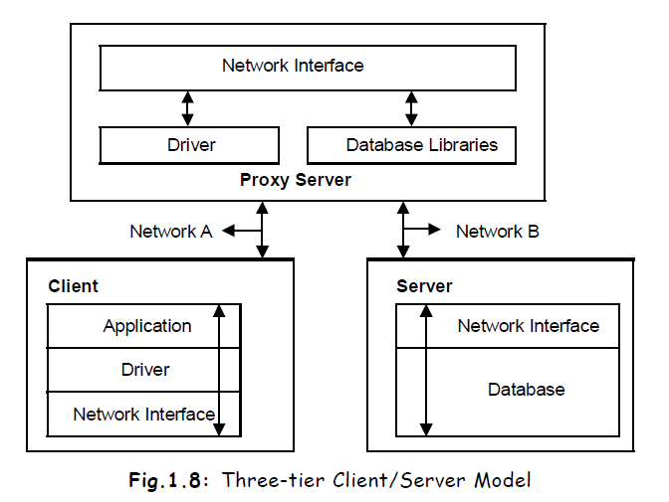

Slide 34
In three-tier model, a third server is employed to handle requests from the client and then pass them off to the database server.
The third server acts as proxy for all client requests.
In other words:
“In three-tier client/server system the client request are handled by intermediate servers which coordinate the execution of the client request with subordinate servers.”
All client requests for the database are routed through the proxy server, thereby creating a more secure environment for your database.

Slide 35
The client uses a driver to translate the client’s request into a database native library call.
In a three-tier environment, the driver translates the request into a “network” protocol and then makes a request via the proxy server.
The proxy server makes the database request on behalf of the client and passes the results back after they have been serviced by the database.
This approach eliminates the need for DBMS to be located on the same server.

Slide 36
There are a couple of drawbacks to this model.
One is that it requires that a small server process (listener) be set up on the middle server.
Secondly, it requires all your client requests be transmitted into a “network” protocol.

Slide 37
First-tier (client-tier):
The main responsibility of this tier is to receive user events and to control the user interface and presentation of data.
As most of the software is removed from the client, the client is called “Thin Client”.
Mainly browser and presentation code resides on this tier.

Slide 38
Second-tier (application-server-tier):
The complex application logic is loaded here and available to the client tier on request from client.
This level forms the central key towards solving the 2-tier problem.
This tier can protect direct access of data.
Object oriented analysis aims in this tier to record and abstract business processing in business projects.
This way it is possible to map this tier directly from the case tools that support object oriented analysis.

Slide 39
Three-tier (database-server-tier):
This tier is responsible for data storage.
This server mostly operates on a relational database.
The boundaries between tiers are logical.
One can run 3-tiers in one and the same machine.
The important fact is that the system is neatly structured and well-planned definitions of the software boundaries exist between the different tiers.

Slide 40
Advantages of three-tier model
Application maintenance is centralized with the transfer of the business logic for many end users into a single application server. This eliminates the concern of software distribution that are problematic in the traditional two-tier Client/Server model.
Clear separation of user-interface-control and data presentation from application logic. Through this separation more clients are able to have access to a wide variety of server applications. The two main advantages for client-applications are clear: quicker development through the reuse of pre-built business-logic components and a shorter test phase, because the server-components have already been tested.

Slide 41
Many users are able to access a wide variety of server applications, as all application logic are loaded in the applications server.
As a rule servers are “trusted” systems. Their authorization is simpler than that of thousands of “untrusted” client-PCs. Data protection and security is simpler to obtain. Therefore, it makes sense to run critical business processes that work with security sensitive data, on the server.

Slide 42
Redefinition of the storage strategy won’t influence the clients. RDBMS’ offer a certain independence from storage details for the clients. However, cases like changing table attributes make it necessary to adapt the client’s application. In the future, even radical changes, like switching from an RDBMS to an OODBMS, won’t influence the client.
Load balancing is easier with the separation of the core business logic from the database server.
Dynamic load balancing: if bottlenecks in terms of performance occur, the server process can be moved to other servers at runtime.

Slide 43
Business objects and data storage should be brought as close together as possible. Ideally, they should be together physically on the same server. This way network load for complex access can be reduced.
The need for less expensive hardware because the client is ‘thin’.
Change management is easier and faster to execute. This is because a component/ program logic/business logic is implemented on the server rather than furnishing numerous PCs with new program versions.

Slide 44
The added modularity makes it easier to modify or replace one tier without affecting the other tier.
Clients do not need to have native libraries loaded locally.
Drivers can be managed centrally.
Your database server does not have to be directly visible to the Internet.
Three-tier architecture maps quite naturally to the Web environment, with a Web browser acting as the ‘thin’ client, and a Web server acting as the application server.

Slide 45
Some disadvantages are:
The client does not maintain a persistent database connection.
A separate proxy server may be required.
The network protocol used by the driver may be proprietary.
You may see increased network traffic if a separate proxy server is used.

Slide 46
Transaction Processing Monitors (TPM)
The three-tier architecture has proved popular in more environments, such as the Internet and company Intranets where a Web browser can be used as a client.
It is also an important architecture for TPM.
A Transaction Processing Monitor is a program that controls data transfer between client and server in order to provide consistent environment, particularly for online transaction processing (OLTP).

Slide 47
Complex applications are often built on top of several resource managers (such as DBMS, operating system, user interface, and messaging software).
A Transaction Processing Monitor or TP Monitor is a middleware component that provides access to the services of a number of resource managers and provides a uniform interface for programmers who are developing transactional software.
Figure illustrates how a TP Monitor forms the middle tier of three-tier architecture.

Slide 48
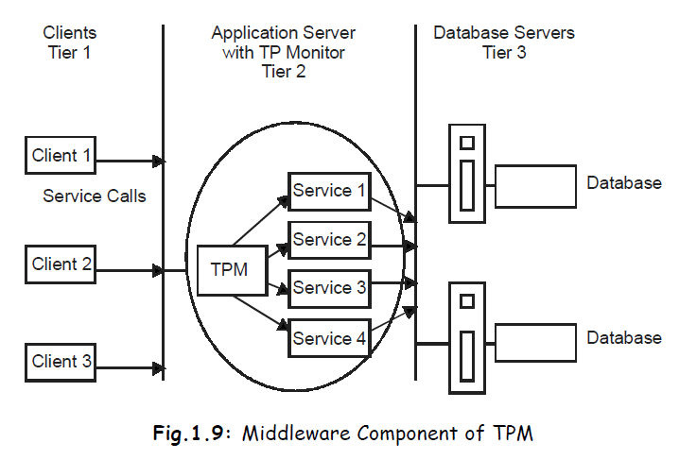

Slide 49
The advantages associated with TP Monitors are :
Transaction Routing
Managing Distributed Transaction
Load balancing
Funneling

Slide 50
The advantages associated with TP Monitors are :
Transaction Routing: TP monitor can increase scalability by directing transactions to specific DBMS’s.
Managing Distributed Transaction: The TP Monitor can manage transactions that require access to data held in multiple, possibly heterogeneous, DBMSs.
For example, a transaction may require to update data item held in an oracle DBMS at site 1, an Informix DBMS at site 2, and an IMS DBMS at site 3.
TP Monitors normally control transactions using the X/Open Distributed transaction processing (DTP) standards.

Slide 51
A DBMS that support this standard can function as a resource manager under the control of a TP Monitor acting as a transaction manager.
Load balancing: The TP Monitor can balance client requests across multiple DBMS’s on one or more computers by directing client services calls to the least loaded server. In addition, it can dynamically bring in additional DBMSs as required to provide the necessary performance.

Slide 52
Funneling: In an environment with a large number of users, it may sometimes be difficult for all users to be logged on simultaneously to the DBMS.
Instead of each user connecting to the DBMS, the TP Monitor can establish connections with DBMS’s as and when required, and can funnel user requests through these connections.
This allows a large number of users to access the available DBMSs with a potentially smaller number of connections, which in turn would mean less resource usages.

Slide 53
Increased reliability: The TP Monitor acts as transaction manager, performing the necessary action to maintain the consistency of database, with the DBMS acting as a resource manager.
If the DBMS fails, the TP Monitor may be able to resubmit the transaction to another DBMS or can hold the transaction until the DBMS becomes available again.

Slide 54
A TP Monitor is typically used in environments with a very heavy volume of transaction, where the TP Monitor can be used to offload processes from the DBMS server.
Examples of TP Monitors include :
CICS and Encina from IBM
Tuxido from BEA system

Slide 55
N-tier Client/Server Model
N-tier computing obliges developer to design components according to a business schema that represents entities, relationship, activities roles, and rules.
It enables them to distribute functionality across logical and physical tiers, allowing better utilization of hardware and platform resources, as well as sharing of those resources and the components that they support to serve several large applications at the same time.

Slide 56
The splitting may be between application logic components, security logic, and presentation logic, computational-intensive and I/O-intensive components and so on.
The most common approach used when designing N-tier system is the three-tier architecture.
Three-tier and N-tier notations are similar, although N-tier architecture provides finer-grained layers.

Slide 57
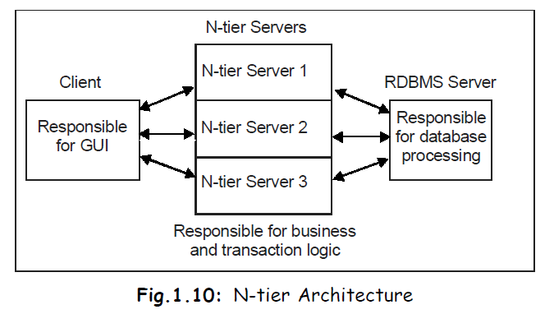

Slide 58
N-tier computing provides many advantages over traditional two-tier or single-tier design :
Overall performance has been improved.
The business logic is centralized.
Enhanced security level is attained.

Slide 59
Model View Controller (MVC)
The Model-View-Controller (MVC) is an architectural pattern that separates an application into three main logical components: the model, the view, and the controller.
Each of these components are built to handle specific development aspects of an application.
MVC is one of the most frequently used industry-standard web development framework to create scalable and extensible projects.
The MVC design pattern serves to separate the presentation layer from the business logic.

Slide 60
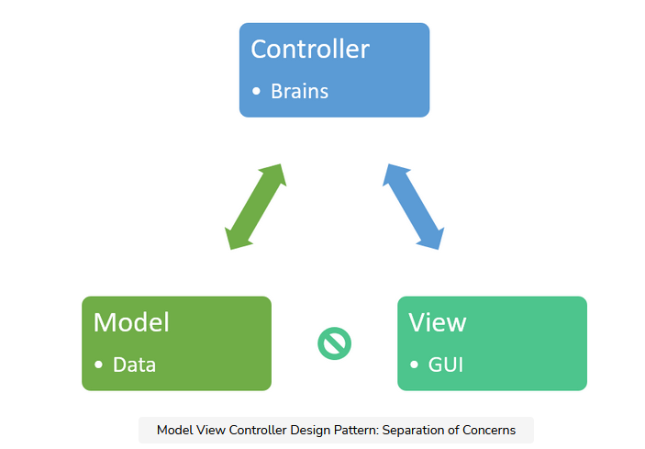

Slide 61
The Model View Controller architectural pattern separates concerns into one of 3 buckets:
Model: stores & manages data. Often a database.
View: Graphical User Interface. The view is a visual representation of the data - like a chart, diagram, table, form.
The view contains all functionality that directly interacts with the user - like clicking a button, or an enter event.
Controller: Brains of the application. The controller connects the model and view.
The controller converts inputs from the view to demands to retrieve/update data in the model.

Slide 62
Benefits of MVC
Traditionally used for Graphical user interfaces (GUIs)
Popular in web applications
MVC responsibilities are divided between the client & server
MVC is helpful design pattern when planning development
Separation of Concerns: that code is divided based on function to either the model, view, or controller bucket
Loosely Coupled
High Cohesion
Reuseable without modification
Code reuse
Extendable code
Easier to maintain or modify
Supports Multiple views
Each part can be tested independently (Model, view, controller)

Slide 63
COMPONENTS
Client/Server architecture is based on hardware and software components that interact to form a system.
The system includes mainly three components.
Hardware (client and server).
Software (which make hardware operational).
Communication middleware. (associated with a network which are used to link the hardware and software).

Slide 64
Client
The client is any computer process that requests services from server.
The client uses the services provided by one or more server processors.
The client is also known as the front-end application, reflecting that the end user usually interacts with the client process.

Slide 65
Server
The server is any computer process providing the services to the client.
It supports multiple and simultaneous clients requests.
The server is also known as back-end application, reflecting the fact that the server process provides the background services for the client process.

Slide 66
Communication Middleware
The communication middleware is any computer process through which client and server communicate.
Middleware is used to integrate application programs and other software components in a distributed environment.
Also known as communication layer.
Communication layer is made up of several layers of software that aids the transmission of data and control information between Client and Server.
Communication middleware is usually associated with a network.

Slide 67
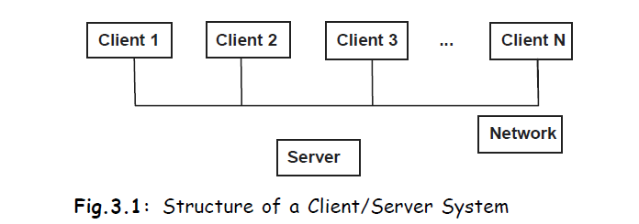
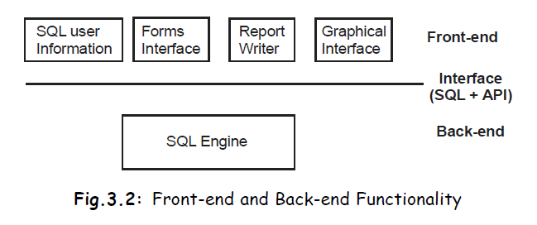

Slide 68
Interaction between the Components
The client process is providing the interface to the end users.
Communication middleware is providing all the possible support for the communication taking place between the client and server processes.
Communication middleware ensures that the messages between clients and servers are properly routed and delivered.
Requests are handled by the database server, which checks the validity of the request, executes them, and send the result back to the clients.

Slide 69
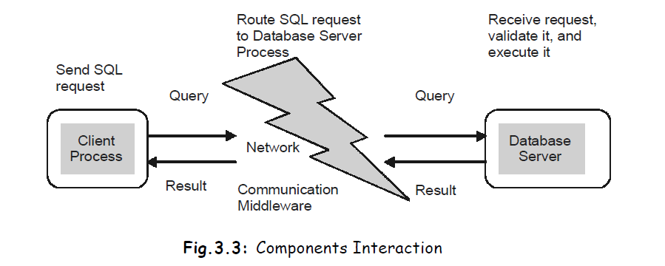

Slide 70
A client application is not restricted to accessing a single service.
The client contacts a different server (perhaps on a different computer) for each service.
A client application is not restricted to accessing a single server for a given service.
A server is not restricted from performing further Client/Server interactions — a server for one service can become a client of another.

Slide 71
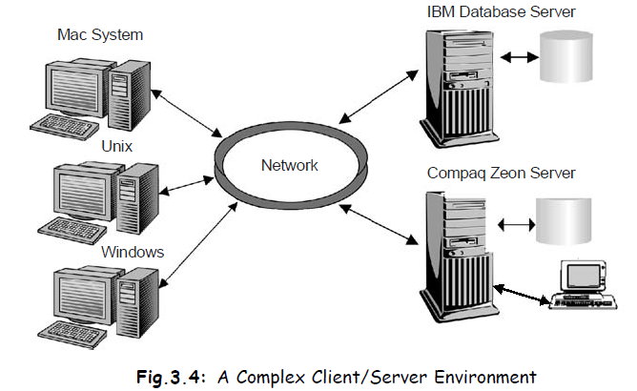
Back-end processes as: IBM Database server process and Compaq Zeon Server
Front-end as: Application client processes (Windows, Unix and Mac Systems)
Middleware as: Communication middleware (network and supporting software)

Slide 72
Principles Behind Client/Server Systems
The components of the Client/Server architecture must conform to some basic principles, if they are to interact properly.
These principles must be uniformly applicable to client, server, and to communication middleware components.

Slide 73
The main principles are as follows:
(i) Hardware independence.
(ii) Software independence.
(iii) Open access to services.
(iv) Process distribution.
(v) Standards.

Slide 74
Hardware independence:
The principles of hardware independence requires that the Client, Server, and communication middleware, processes run on multiple hardware platforms (IBM, DEC, Compaq, Apple, and so on) without any functional differences.

Slide 75
Software independence:
The principles of software independence requires that the Client, Server, and communication middleware processes
support multiple operating systems (such as Windows 98, Windows NT, Apple Mac system, OS/2, Linux, and Unix)
multiple network protocols (such as IPX, and TCP/IP), and
multiple application (spreadsheet, database electronic mail and so on).

Slide 76
Open access to services :
All client in the system must have open (unrestricted) access to all the services provided within the network, and these services must not be dependent on the location of the client or the server.
A key issue is that the services should be provided on demand to the client.
In fact, the provision of on-demand service is one of the main objectives of Client/Server computing model.

Slide 77
Process distribution :
A primary identifying characteristic of Client/Server system is that the processing of information is distributed among Clients and Servers.
The division of the application-processing load must conform to the following rules:
Client and server processes must be autonomous entities with clearly defined boundaries and functions. This property enables us to clearly define the functionality of each side, and it enhances the modularity and flexibility of the system.
Local utilization of resources (at both client and server sides) must be maximized. The client and server process must fully utilize the processing power of the host computers. This property enables the system to assign functionality to the computer best suited to the task. A server process should service multiple requests from multiple clients.

Slide 78
Scalability and flexibility requires that the client and server process be easily upgradeable to run on more powerful hardware and software platforms. This property extends the functionality of Client/Server processes when they are called upon to provide the additional capabilities or better performance.
Interoperability and integration requires that client and server processes be seamlessly integrated to form a system. Swapping a server process must be transparent the client process.

Slide 79
Standards:
finally all the principles that are formulated must be based on standards applied within the Client/Server architecture.
For example, standard must govern the user interface, data access, network protocols, interprocess communications and so on.
Standards ensure that all components interact in an orderly manner to achieve the desired results.
There is no universal standard for all the components.
The fact is that there are many different standards from which to choose.
For example, an application can be based on Open Database Connectivity (ODBC) instead of Integrated Database Application Programming Interface (IDAPI) for Data access (ODBC and IDAPI are database middleware components that enables the system to provide a data access standard for multiple processes.)

Slide 80
Architecture For Business Information System
We will discuss several patterns for distributing business information systems that are structured according to a layered architecture.
Each distribution pattern cuts the architecture into different client and server components.
All the patterns discussed give an answer to the same question: How do I distribute a business information system?

Slide 81
While constructing the architecture for a business information system, which will be deployed across a set of distributed processing units (e.g., machines in a network, processes on one machine, threads within one process), you are faced with the question:
How do I partition the business information system into a number of client and server components, so that my users’ functional and non-functional requirements are met?
There are several answers to this question.
The decision for a particular distribution style is driven by users’ requirements.
It significantly influences the software design and requires a very careful analysis of the functional and non-functional requirements.

Slide 82
Three-Layer Architecture
General Forces
Distribution Pattern

Slide 83
Three-Layer Architecture
A Business Information System, in which many users work in parallel on a large amount of data.
The system supports distributed business processes, which may span a single department, a whole enterprise, or even several enterprises.
The system must support more than one type of data processing, such as On-Line Transaction Processing (OLTP), off-line processing or batch processing.
Typically, the application architecture of the system is a Three-Layer Architecture, illustrated in Fig.

Slide 84
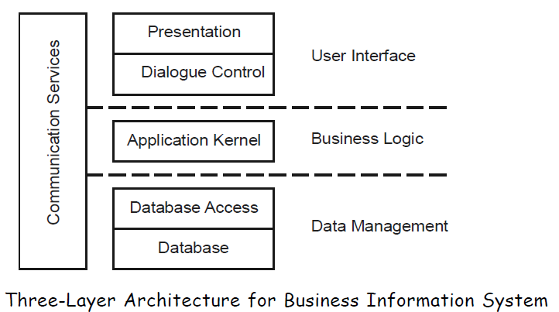

Slide 85
The user interface handles presentational tasks and controls the dialogue.
The application kernel performs the domain specific business tasks.
The database access layer connects the application kernel functions to a database.
In developing distributed system architecture we mainly use the Client/Server Style.
Within these model two roles, client and server classify components of a distributed system.
Clients and servers communicate via a simple request/response protocol.

Slide 86
General Forces
Business needs vs. construction complexity
Processing style
Distribution vs. performance
Distribution vs. security
Distribution vs. consistency
Software distribution cost
Reusability vs. performance vs. complexity

Slide 87
Distribution Pattern
To distribute an information system by assigning client and server roles to the components of the layered architecture we have the choice of several distribution styles.
Figure 3.9 shows the styles, which build the pattern language.
An abstract for each pattern:
Distributed presentation
Remote user interface
Distributed application kernel
Remote database
Distributed database

Slide 88
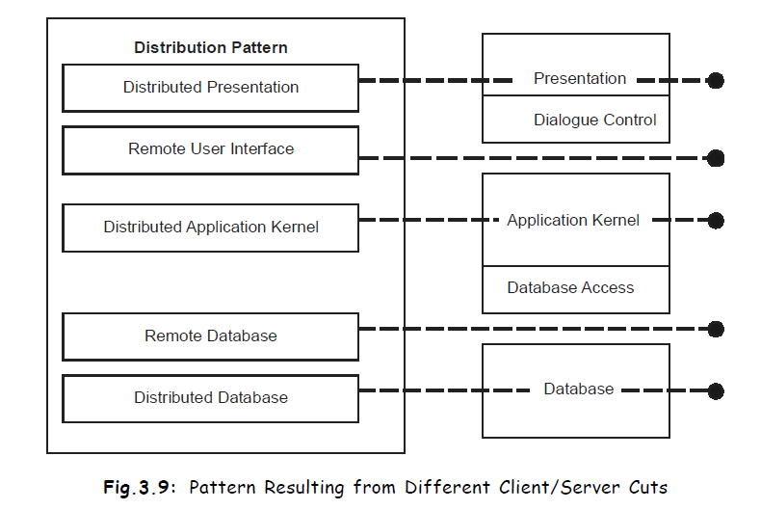

Slide 89
Distributed presentation
This pattern partitions the system within the presentation component.
One part of the presentation component is packaged as a distribution unit and is processed separately from the other part of the presentation, which can be packaged together with the other application layers.
This pattern allows of an easy implementation and very thin clients. Host systems with 3270-terminals is a classical example for this approach.
Network computers, Internet and intranet technology are modern environments where this pattern can be applied as well.

Slide 90
Remote user interface:
Instead of distributing presentation functionality the whole user interface becomes a unit of distribution and acts as a client of the application kernel on the server side.
Distributed application kernel:
The pattern splits the application kernel into two parts which are processed separately.
This pattern becomes very challenging if transactions span process boundaries (distributed transaction processing).

Slide 91
Remote database:
The database is a major component of a business information system with special requirements on the execution environment.
Sometimes, several applications work on the same database.
This pattern locates the database component on a separate node within the system’s network.

Slide 92
Distributed database:
The database is decomposed into separate database components, which interact by means of interprocess communication facilities.
With a distributed database an application can integrate data from different database systems or data can be stored more closely to the location where it is processed.

Slide 93
Existing Client/Server Architecture
Mainframe-based Environment
LAN-based Environment
Internet-based Environment

Slide 94
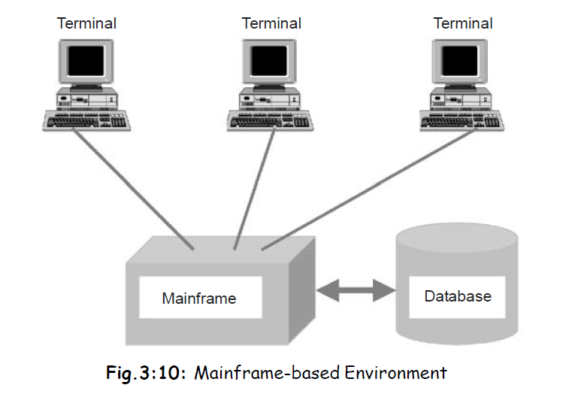
Mainframe-based Environment

Slide 95
In mainframe systems all the processing takes place on the mainframe and usually dumb terminals that are known as end user platform are used to display the data on screens.
Dumb terminals do not have any autonomy.
Mainframes systems
are highly centralized known to be integrated systems.
have very limited data manipulation capabilities from the application development point of view.
are over structured, time-consuming and create application backlogs.
Various computer applications were implemented on mainframe computers (from IBM and others), with lots of attached (dumb, or semi-intelligent) terminals see the Fig. 3.10.

Slide 96
There are some major problems with this approach:
Mainframe system are very inflexible.
Vendor lock-in was very expensive.
Centralized DP department was unable to keep up with the demand for new applications.

Slide 97
LAN-based Environment
LAN can be configured as a Client/Server LAN in which one or more stations called servers give services to other stations, called clients.
The server version of network operating system is installed on the server or servers.
The client version of the network operating system is installed on clients.
A LAN may have a general server or several dedicated servers.
A network may have several servers; each dedicated to a particular task for example database servers, print servers, and file servers, mail server.
Each server in the Client/Server based LAN environment provides a set of shared user services to the clients.
These servers enable many clients to share access to the same resources and enable the use of high performance computer systems to manage the resources.

Slide 98
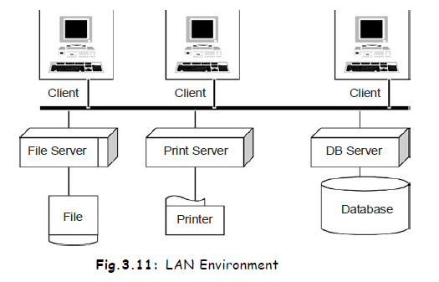

Slide 99
A file server allows the client to access shared data stored on the disk connected to the file server. When a user needs data, it access the server, which then sends a copy.
A print server allows different clients to share a printer. Each client can send data to be printed to the print server, which then spools and print them.
In this environment, the file server station server runs a server file access program, a mail server station runs a server mail handling program, and a print server station a server print handling program, or a client print program.
Users, applications and resources are distributed in response to business requirements and linked by single Local Area Networks.

Slide 100
Internet-based Environment
Internet brings a new platform, interface, and architectures.
The internet can employ existing Client/Server applications as true Internet applications, and integrate applications in the Web browser.
The Internet also means that the vast amount of information becomes available from the same application environment and the interface.

Slide 101
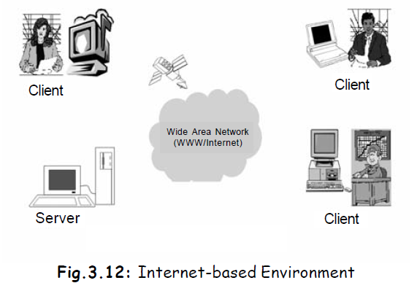
Since most internet applications are driven from the Web server, the application processing is moving off the client and back onto the server.
This means that maintenance and application deployment become much easier.

Slide 102
The web browsers are universal clients.
A web browser is a minimalist client that interprets information it receives from a server, and displays it graphically to a user.
The client is simply here to interpret the server’s command and render the contents of an HTML page to the user.
HTTP server produce platform independent content that clients can then request.
A server does not know a PC client from a Mac client – all web clients are created equal in the eyes of their web server.
Browsers are there to take care of all the platform-specific details.

